Slide 1
Group E Installation of C and C++
Syed Wakeer
Santhosh Kumar
th

Slide 2

C Installation on Linux

Slide 3
Command to install C:
gcc –-version
Sudo apt install gcc

Slide 4
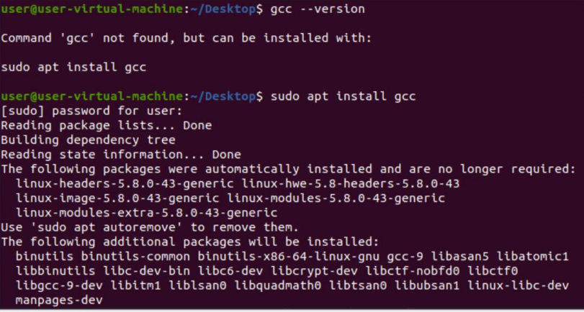
Output:

Slide 5
Command to Compile:
gcc filename.c
Command to Run:
./a.out

Slide 6
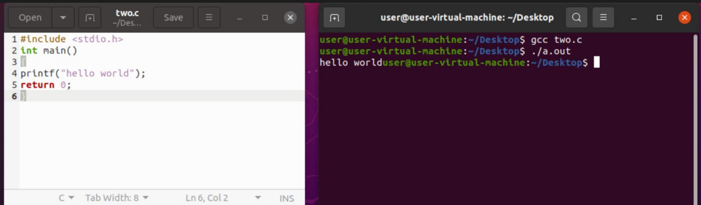
Output

Slide 7
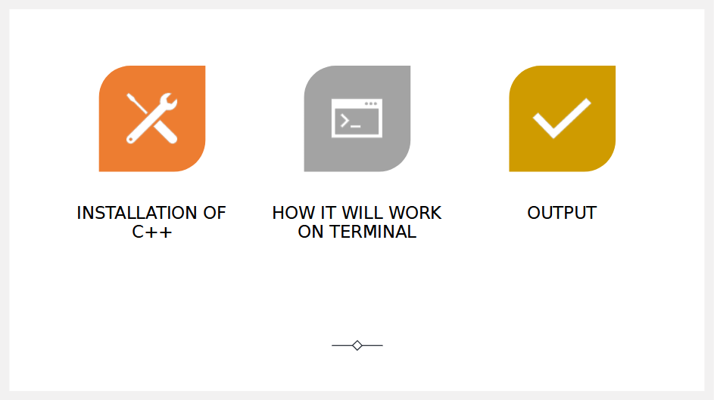

Slide 8
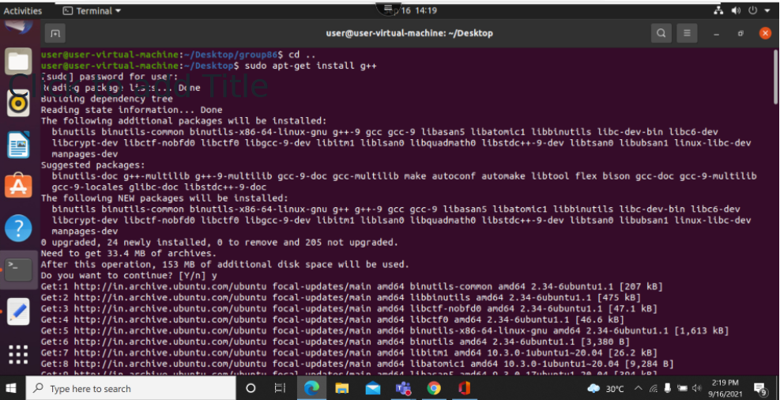

Slide 9
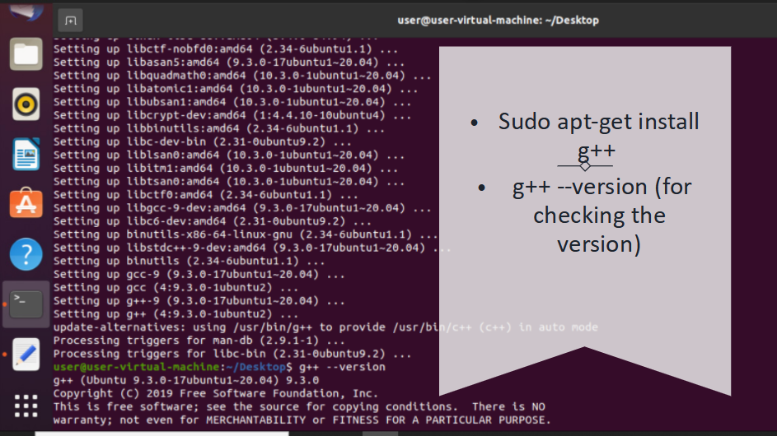

Slide 10
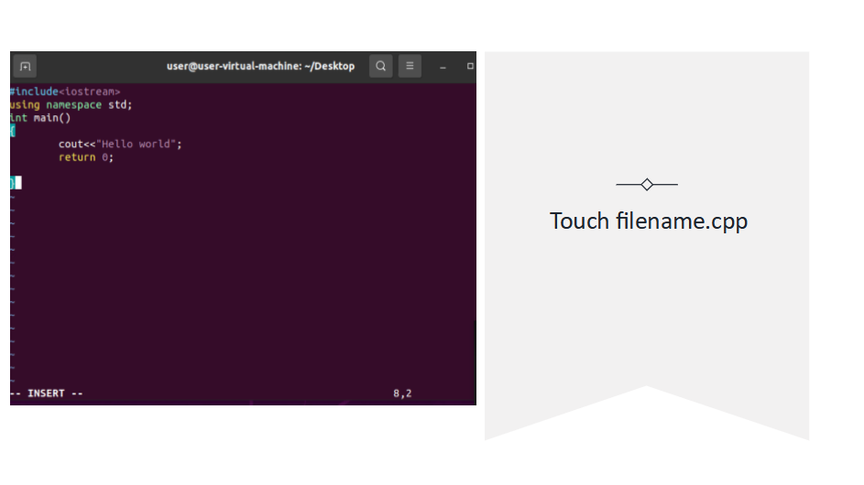

Slide 11
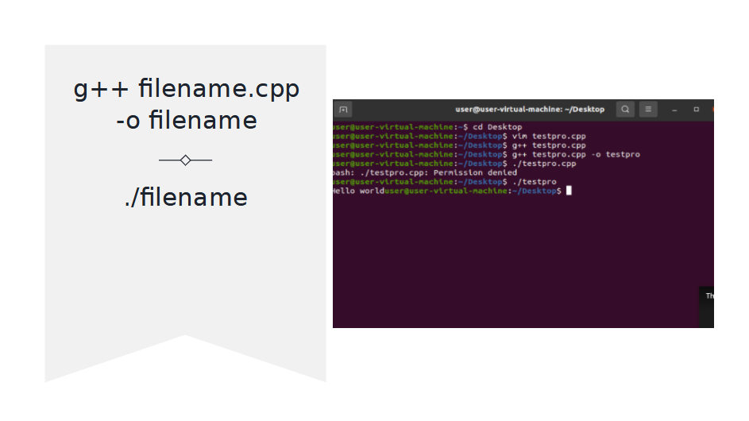

Slide 12
Thank You

